Slide 1

Department of Computer Science and Engineering
Project Review on
AQUA PLASTIC DETECT
Presented By
Batch No: D8
Sk.Sabiha Sultana 23FE1A05P1
Joycee Fleroma.V 23FE1A05N7
Hemanth Rapolu 23FE1A05J5
Lokesh Salimetty 23FE1A05K2
Under The Esteemed Guidance of
Mrs.R.Pushpalatha
Assistant Professor
CSE Department
12/09/2025
Department of Computer Science & Engineering

Slide 2

TITLE
AQUA PLASTIC DETECT
24/05/2021
Department of Computer Science & Engineering
12/09/2025
Department of Computer Science & Engineering
2

Slide 3
CONTENTS
Title
Abstract
Introduction
Literature Survey
Existing System
Proposed System
Proposed Methodology
Conclusion
12/09/2025
Department of Computer Science & Engineering

Slide 4
ABSTRACT
Microplastics are Tiny Plastic particles that contaminate drinking water and pose serious risks to human health and the environment. Current detection methods rely on costly laboratory techniques that are not accessible to common users. To address this, our project Aqua-Plastic Detect introduces a website-based simulation that analyzes uploaded water sample images and estimates whether the Plastic present inside the water or not. Additionally, a 3D virtual model of a detection device with labeled parts is presented to visualize how a real-world solution could work in the future. This project serves as a prototype to raise awareness and demonstrate the potential of affordable, portable detection systems.
12/09/2025
Department of Computer Science & Engineering

Slide 5
INTRODUCTION
Plastic pollution has become a major global concern, especially in water bodies.
Every year, millions of tons of plastics enter oceans, rivers, and lakes, breaking down into microplastics (<5mm in size).
They originate from industrial waste, packaging materials, cosmetics, and degradation of larger plastics.
These particles are harmful to aquatic life and may cause long-term health risks in humans.
There is no Portable, Affordable system for real-time detection of Microplastics.
12/09/2025
Department of Computer Science & Engineering

Slide 6
INTRODUCTION
Current detection methods (FTIR, Raman spectroscopy) are costly, lab-based, and not accessible to the public.
Our project, AQUA -PLASTIC DETECT, proposes a simulation-based website and a 3D prototype device to demonstrate how detection could be simplified and made user-friendly.
Along with this, we present a 3D virtual model of a POLY-SCAN device to visualize how a real-time detection device could look and function in the future.
12/09/2025
Department of Computer Science & Engineering

Slide 7
LITERATURE SURVEY
S.No | Paper Title | Methodology | Drawbacks | Proposed Methodology to overcome those drawbacks
2. | Polarized Scattering (2021) Low-cost Raman Prototype (2021) | In-situ light scattering + ML Budget optical Raman device | Lab apparatus; natural variability Limited sensitivity | Future Integration in field devices Affordable for broad deployment
12/09/2025
Department of Computer Science & Engineering

Slide 8
LITERATURE SURVEY
S.No | Paper Title | Methodology | Drawbacks | Proposed Methodology to overcome those drawbacks
3. 4. | µ-Raman + ML (2023). Fluorescence Imaging + ML (2025) | Deep learning on Raman spectra. Nile Red + imaging + ML | Lab-only equipment required. Lab-based, uses dyes | Human machine teaming speeds process. High resolution for small MPs
12/09/2025
Department of Computer Science & Engineering

Slide 9
EXISTING SYSTEM
The current systems for detecting microplastics rely entirely on laboratory-based technologies. While accurate, these systems have the following limitations:
Require specialized laboratory equipment.
Expensive and time-consuming processes.
Not accessible for everyday users.
Cannot be used in real-time scenarios (e.g., testing drinking water at home). Thus, there is a pressing need for innovative solutions that are cost-effective, easy to use, and capable of reaching the general public.
12/09/2025
Department of Computer Science & Engineering

Slide 10
EXISTING SYSTEM
Optical Imaging Systems: Use high-resolution cameras + microscopes to detect microplastics in filtered water samples.
Turbidity/Optical Scattering Sensors: Low-cost sensors that measure how light scatters in water, giving an indication of suspended plastics; portable but not very specific.
Underwater Drones with Imaging Systems: Research prototypes use cameras + AI to detect floating macro-plastics in oceans and rivers; useful for large debris, not microplastics.
FTIR Spectrometers (Fourier Transform Infrared): Used in labs to identify plastic particles based on their infrared absorption spectrum; highly accurate but bulky and costly.
12/09/2025
Department of Computer Science & Engineering

Slide 11
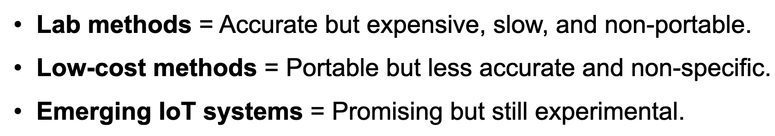
EXISTING SYSTEM DRAWBACKS
`
12/09/2025
Department of Computer Science & Engineering

Slide 12
It is designed as a website-based simulation tool for detecting microplastics in water.
PROPOSED SYSTEM
The Proposed system is named AQUA-PLASTIC DETECT.
It is designed as a website-based simulation tool for detecting microplastics in water samples.
Users can upload images of water samples through the website.
The system uses image analysis techniques to estimate whether the plastic particles are present in the sample.
Alongside the website, a 3D virtual model of a detection device (Poly-Scan) is created.
The 3D device model contains labeled parts such as sensors, motherboard, battery, LEDs, and display unit.
12/09/2025
Department of Computer Science & Engineering

Slide 13
PROPOSED SYSTEM
This device visually explains how a future real-time detection system could function.
The proposed system makes microplastic detection appear simple, affordable, and user-friendly compared to existing lab methods.
Though real detection of microplastics is not yet possible without advanced sensors, the simulation creates an awareness model.
It also acts as an Educational and Awareness tool for students, researchers, and the public.
12/09/2025
Department of Computer Science & Engineering

Slide 14
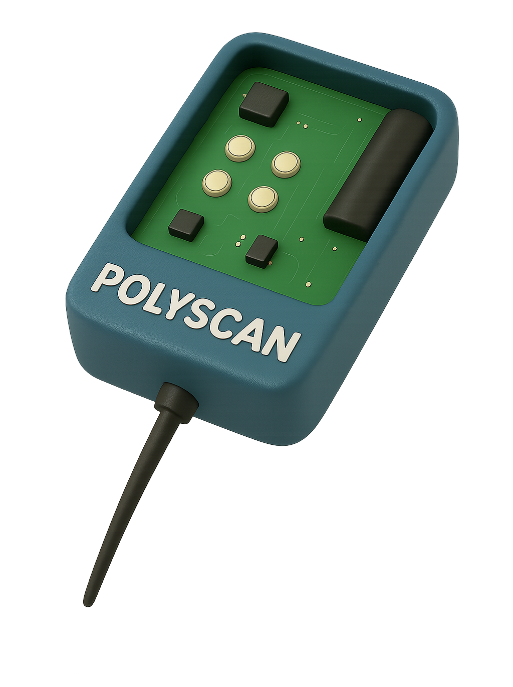
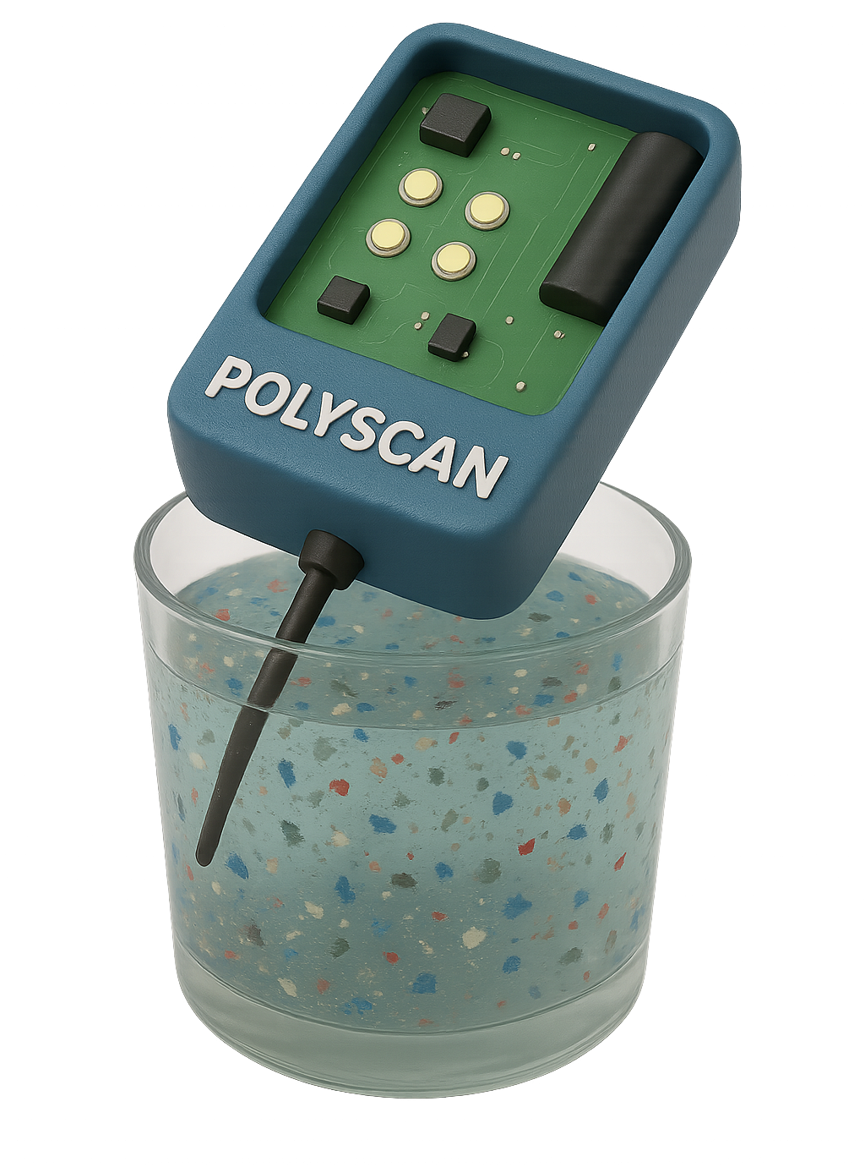
PROPOSED SYSTEM
POLY-SCAN DEVICE
DEVICE TESTING IN THE WATER FOR PLASTIC.
12/09/2025
Department of Computer Science & Engineering

Slide 15
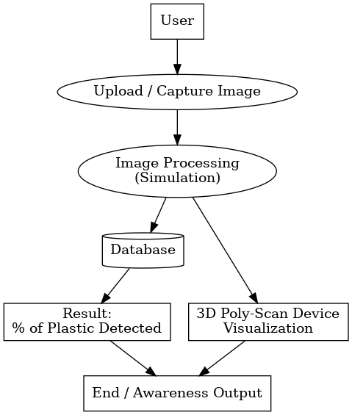
SYSTEM ARCHITECTURE
12/09/2025
Department of Computer Science & Engineering

Slide 16
PROPOSED METHODOLOGY
Image Upload-
Users upload a water sample image through the website.
Preprocessing-
The system resizes and enhances the image to remove noise and improve clarity.
3. Feature Detection-
The tool scans the image for unusual particles based on color, shape, and
texture that may indicate plastic.
4. Analysis & Decision-
The system applies simple rules or a trained model to decide if plastic-like
particles are present.
A confidence score (e.g., 80% likely) is generated.
12/09/2025
Department of Computer Science & Engineering

Slide 17
PROPOSED METHODOLOGY
5. Result Display-
The website shows the result with highlights/marks on the detected regions.
A note is displayed that this is a simulation for awareness, not a lab test.
6. 3D Poly-Scan Device Visualization-
A 3D model of the future device is provided.
Users can view labeled parts like sensors, motherboard, LEDs, battery, and display.
It demonstrates how a real detection device might work.
7. Educational Purpose-
The tool explains microplastic pollution in water.
It serves as an awareness and learning platform for students, researchers, and the public.
12/09/2025
Department of Computer Science & Engineering

Slide 18
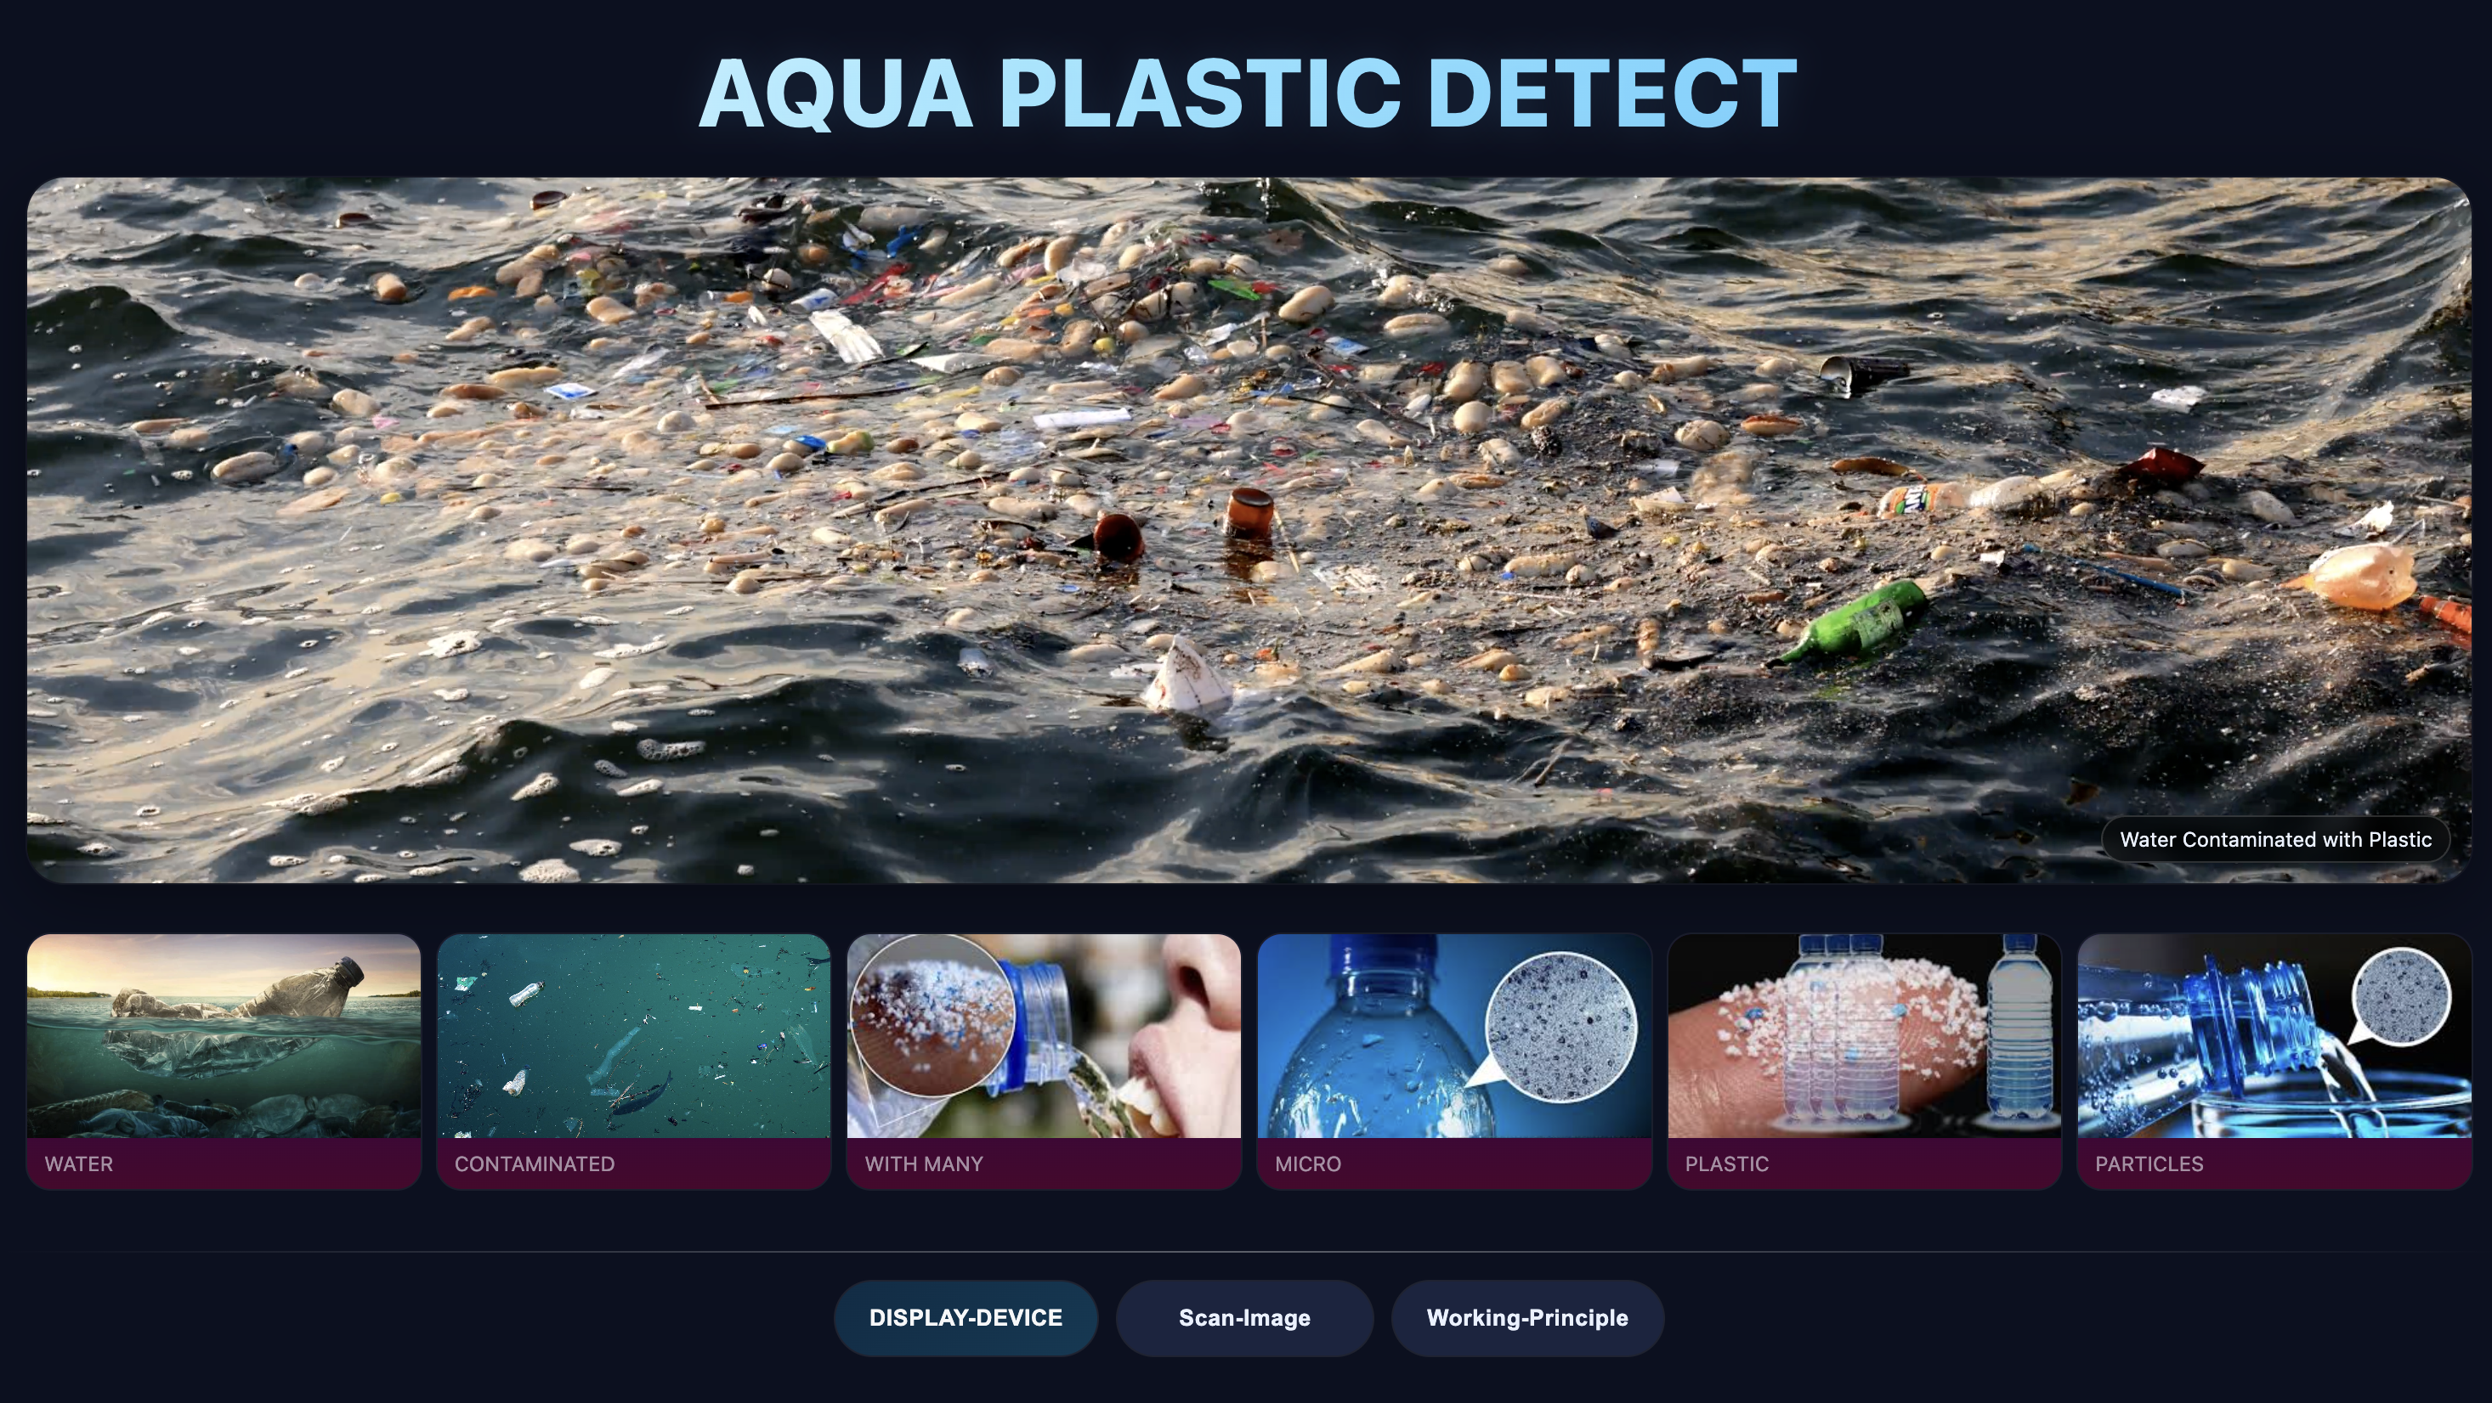
RESULTS OF THE PROJECT
HOME PAGE
12/09/2025
Department of Computer Science & Engineering

Slide 19
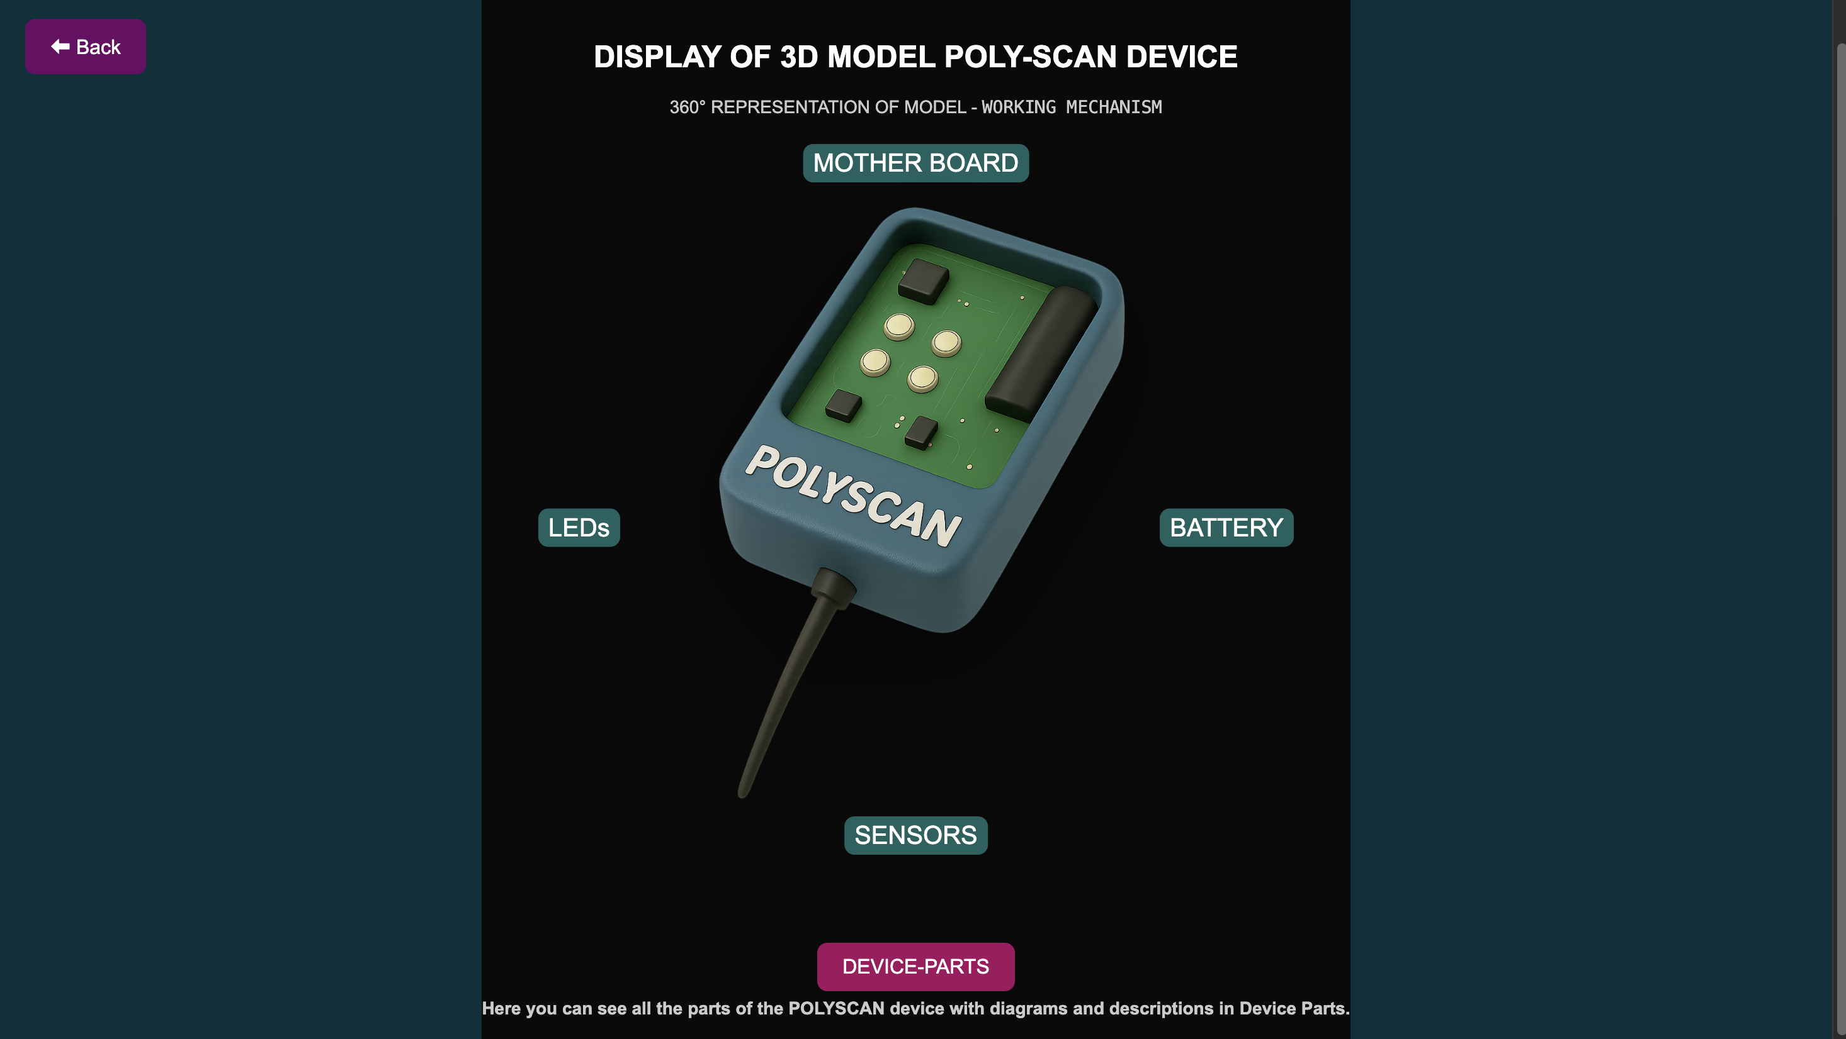
DEVICE-DISPLAY PAGE
12/09/2025
Department of Computer Science & Engineering

Slide 20
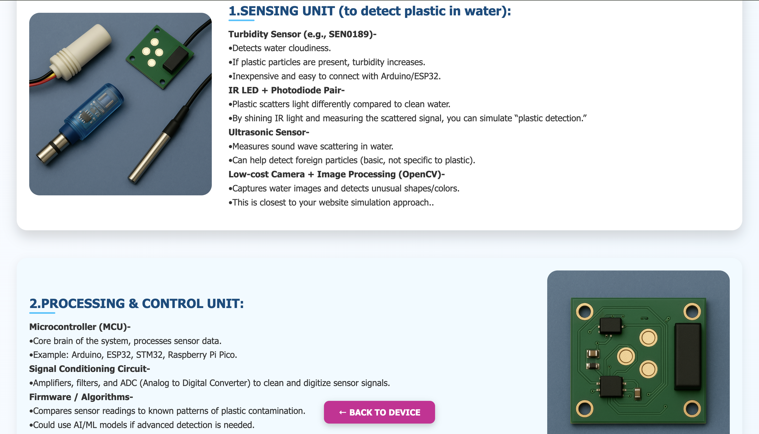
DEVICE-PARTS PAGE
12/09/2025
Department of Computer Science & Engineering

Slide 21
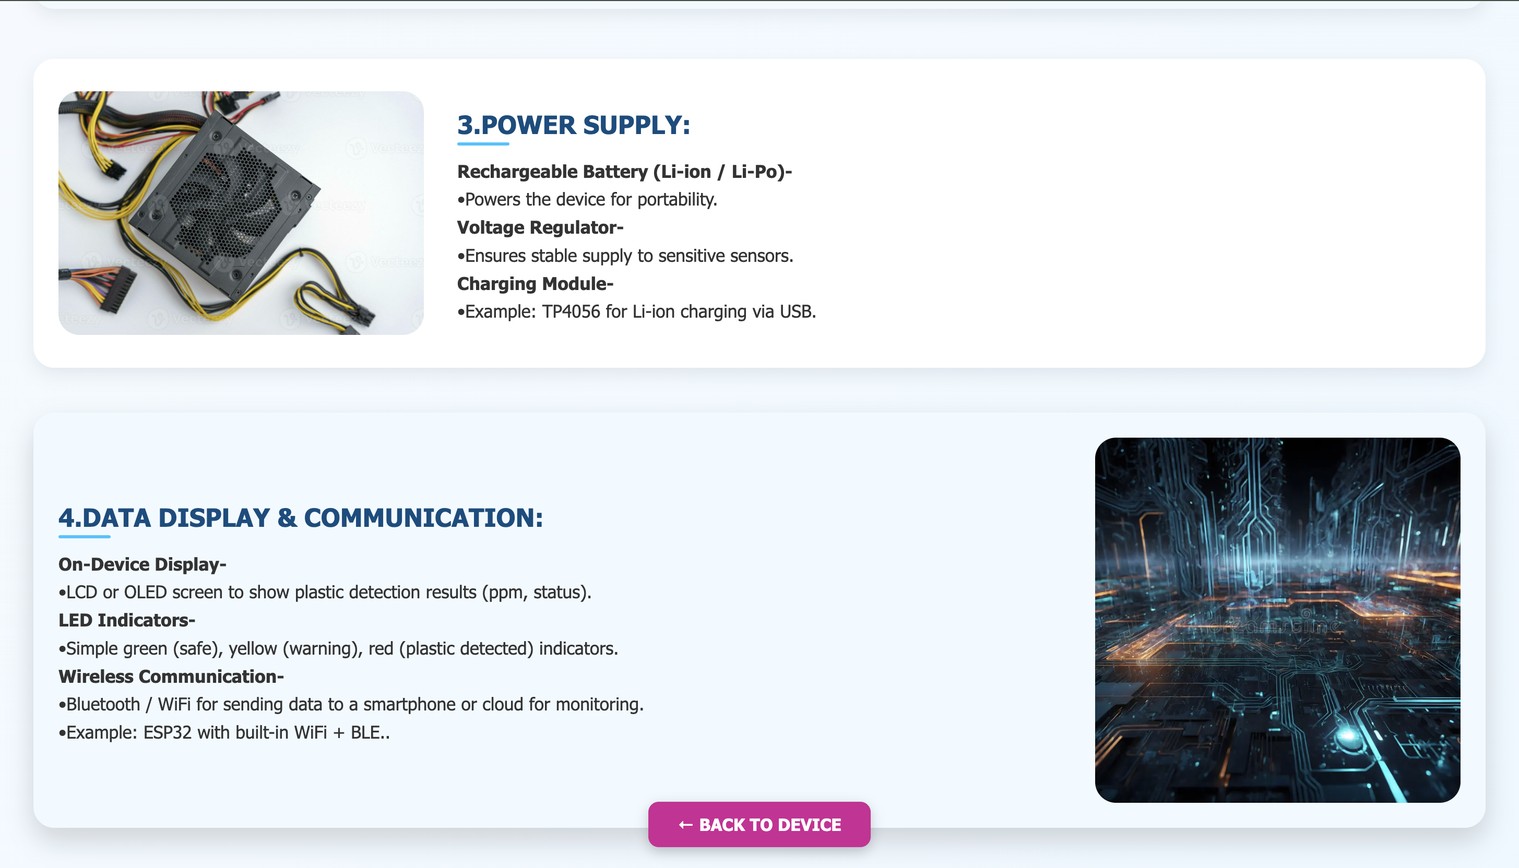
DEVICE-PARTS PAGE
12/09/2025
Department of Computer Science & Engineering

Slide 22
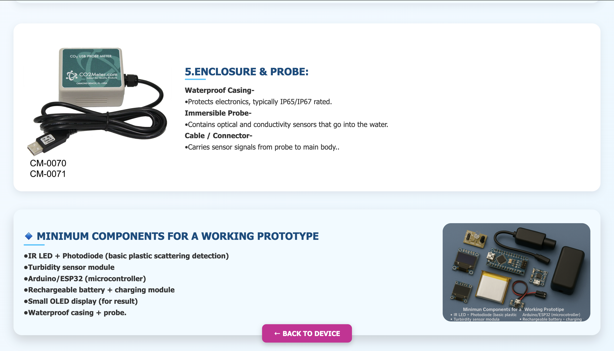
DEVICE-PARTS PAGE
12/09/2025
Department of Computer Science & Engineering

Slide 23
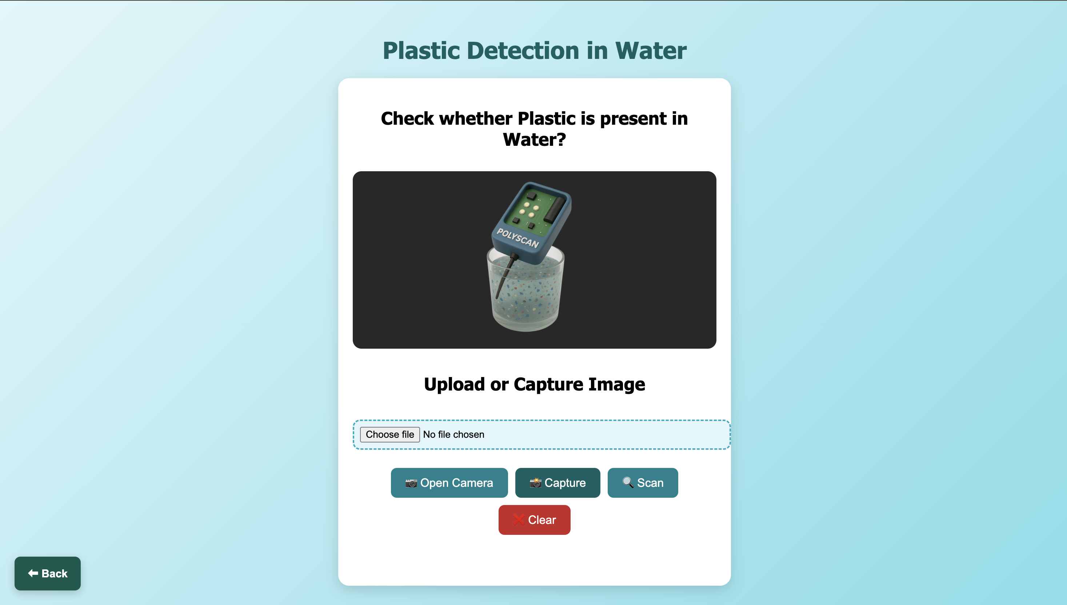
SCAN-IMAGE PAGE
12/09/2025
Department of Computer Science & Engineering

Slide 24
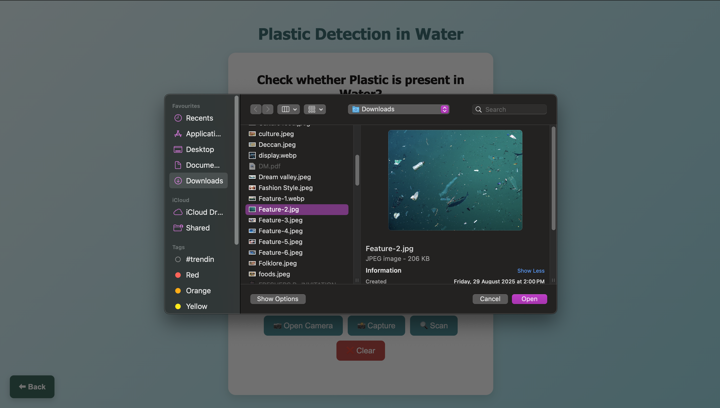
SCAN-IMAGE PAGE
12/09/2025
Department of Computer Science & Engineering

Slide 25
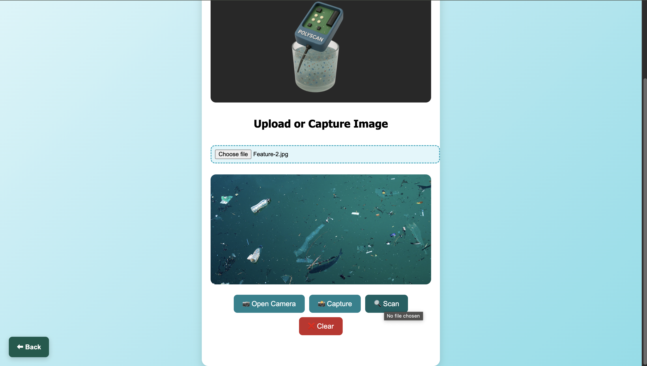
SCAN-IMAGE PAGE
12/09/2025
Department of Computer Science & Engineering

Slide 26
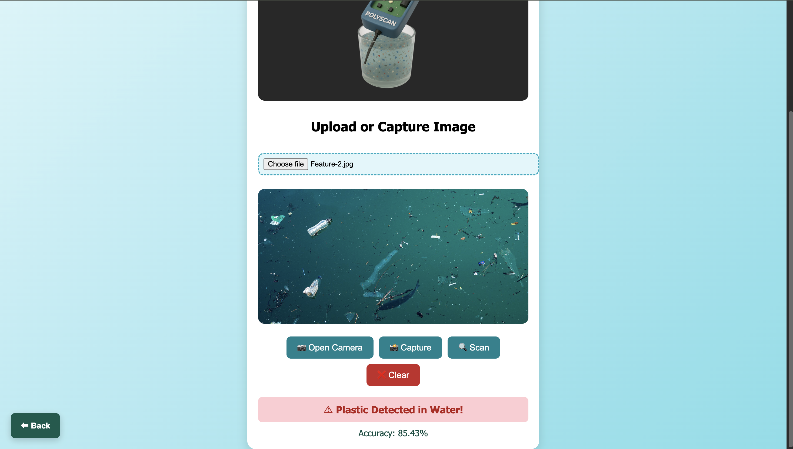
SCAN-IMAGE PAGE
12/09/2025
Department of Computer Science & Engineering

Slide 27
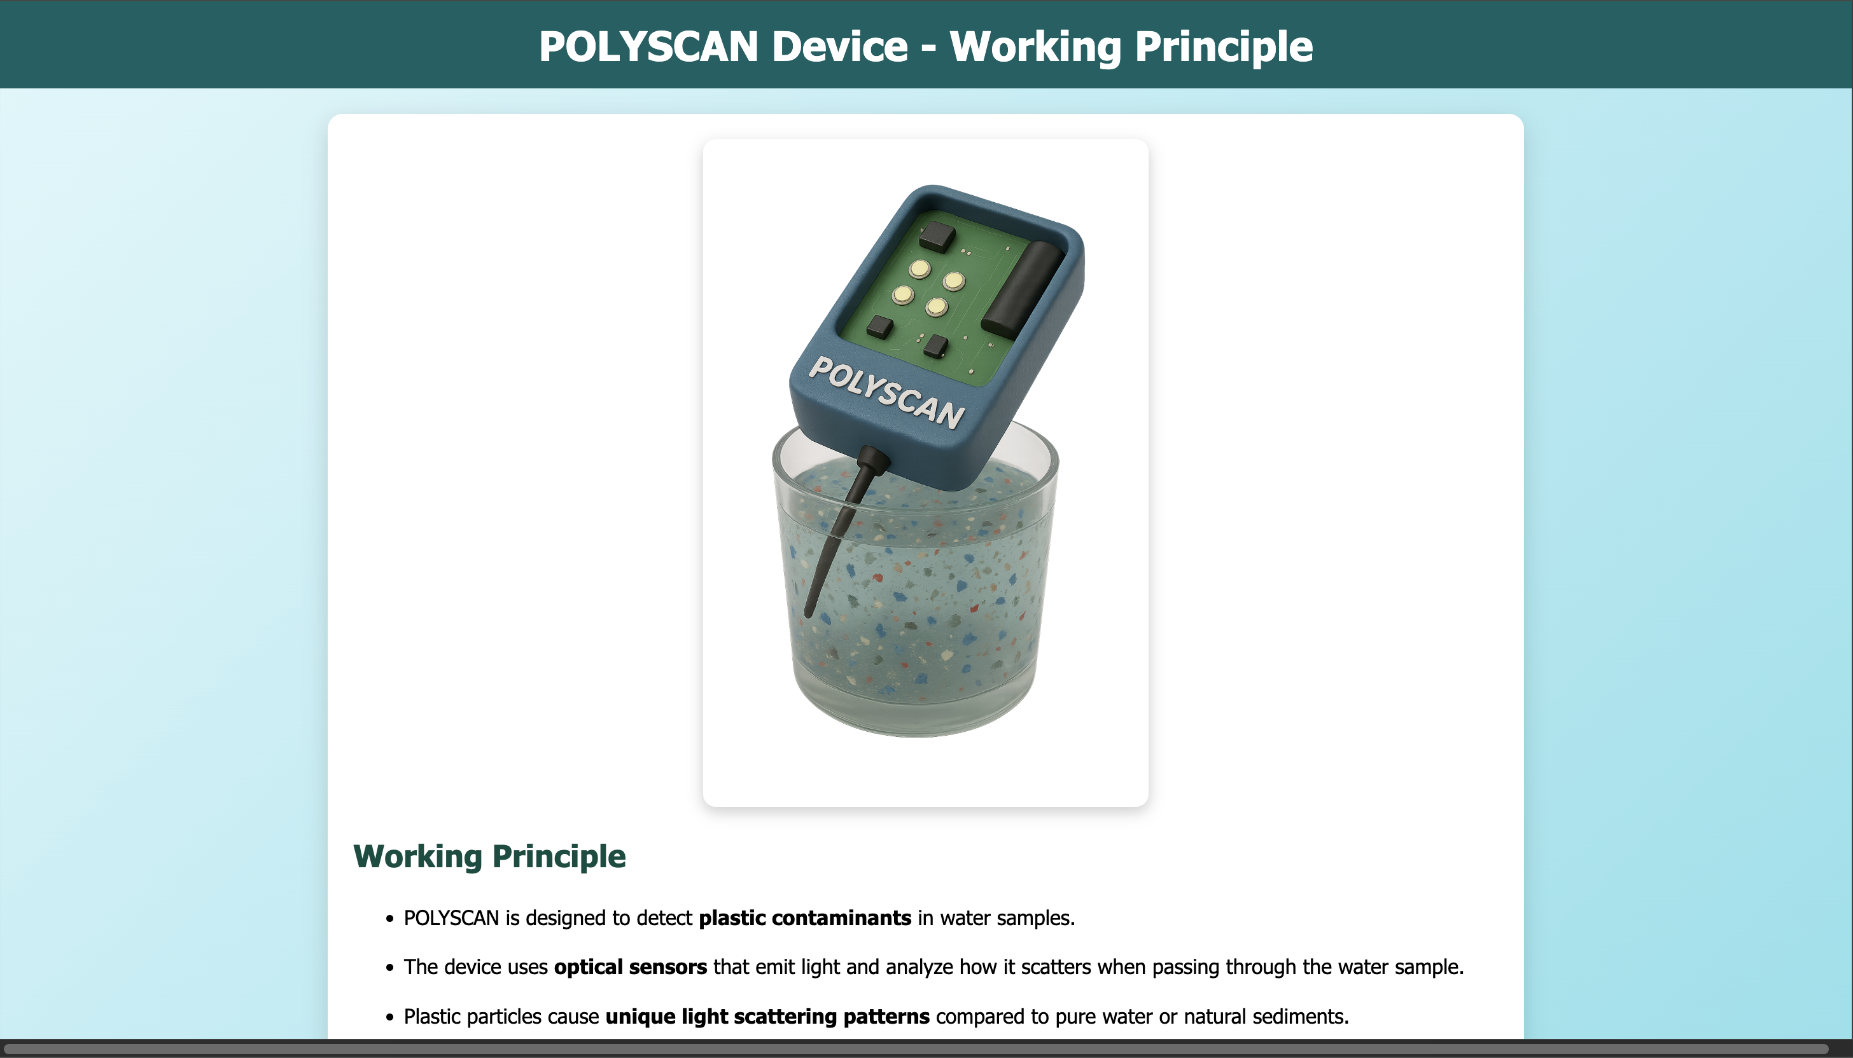
WORKING-MECHANISM PAGE
12/09/2025
Department of Computer Science & Engineering

Slide 28
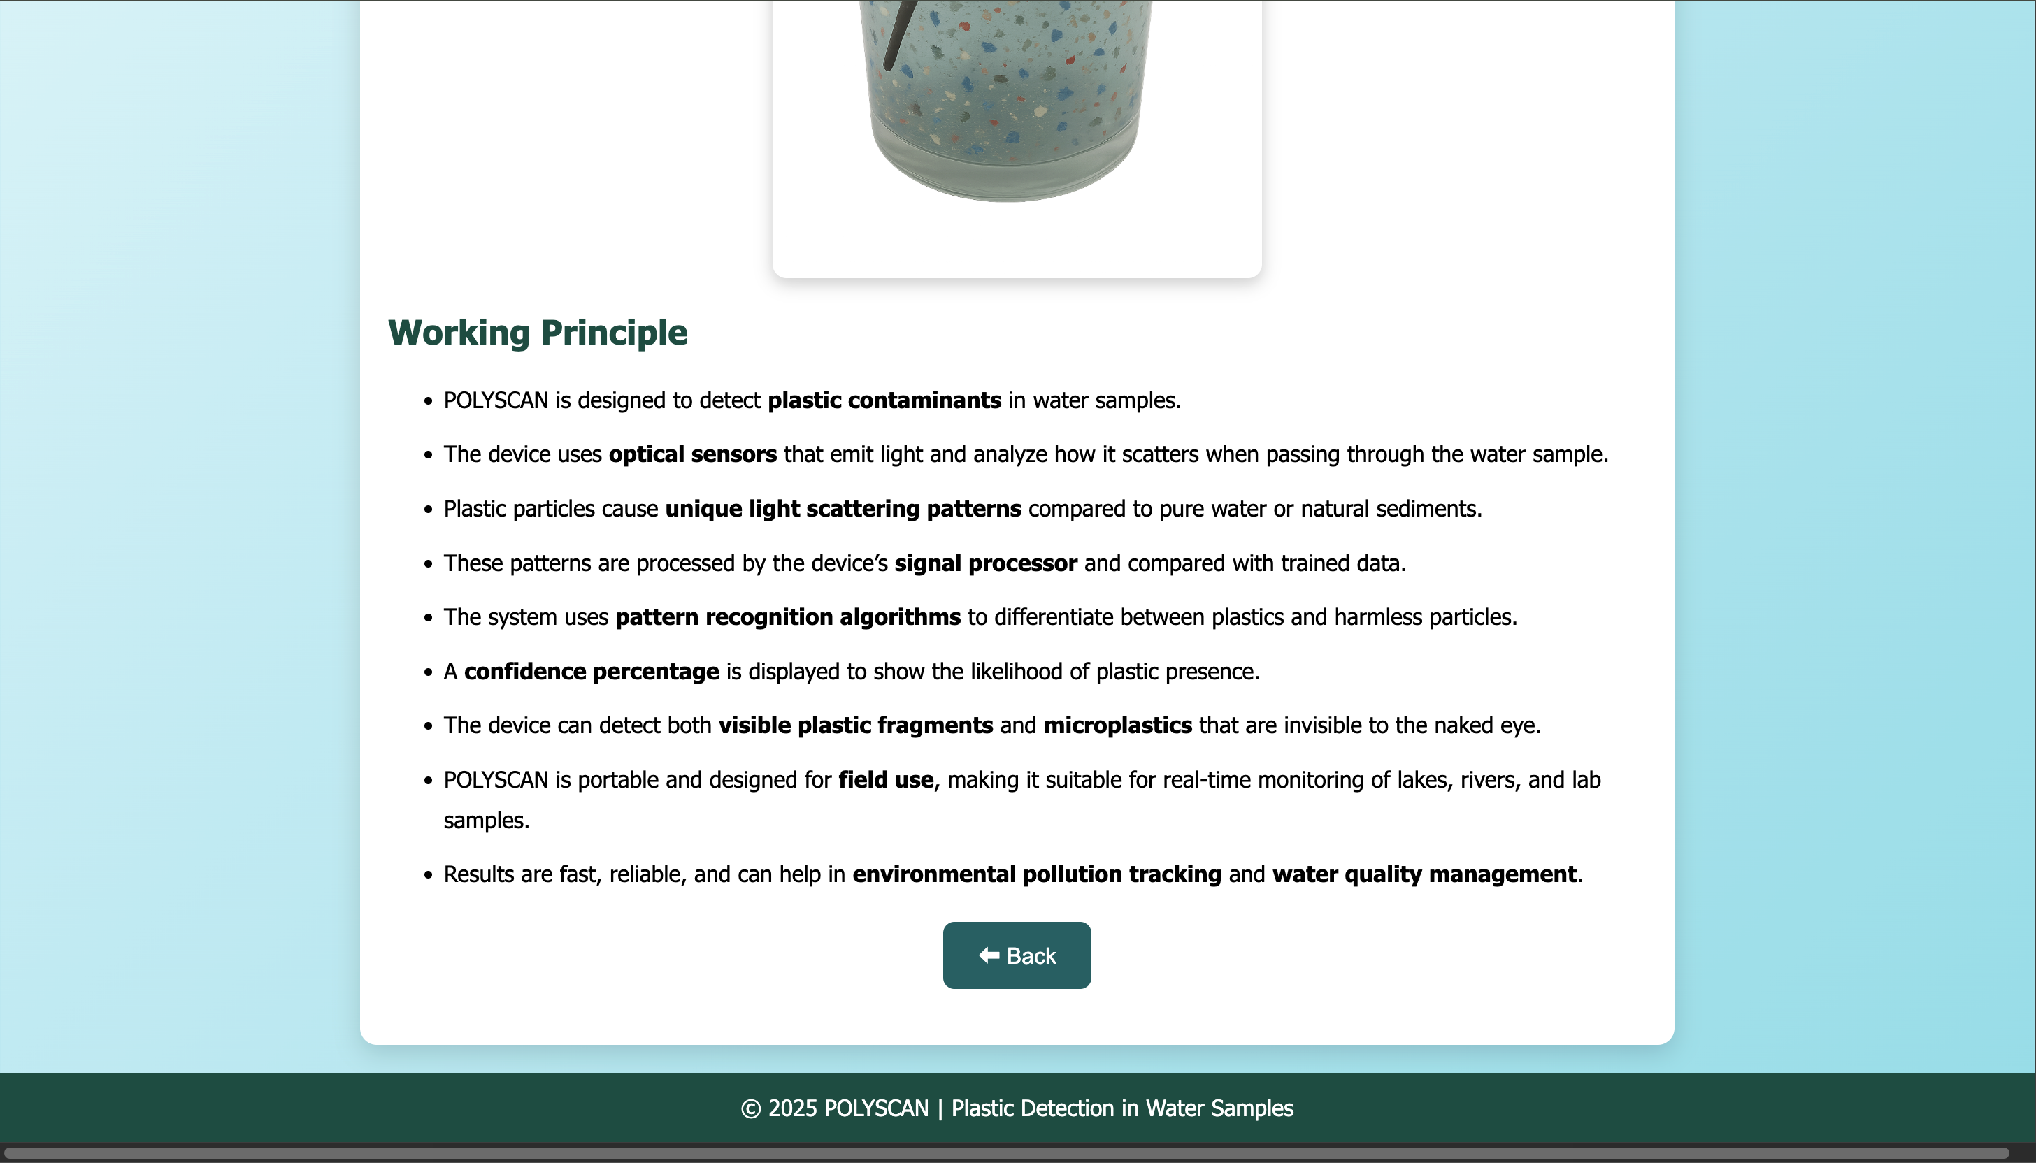
WORKING-MECHANISM PAGE
12/09/2025
Department of Computer Science & Engineering

Slide 29
CONCLUSION
The proposed system AQUA-PLASTIC DETECT provides a website-based simulation tool to identify plastic-like particles in water samples through image analysis. By allowing users to upload images and receive results with visual highlights, the system makes microplastic detection appear simple and user-friendly. The inclusion of a 3D Poly-Scan device model further demonstrates how a real detection device could function in the future. While it does not perform real microplastic testing, the project effectively serves as an educational and awareness platform. It encourages students, researchers, and the public to understand the growing issue of plastic pollution in water. This simulation creates a foundation for future development of affordable, real-time detection devices.
12/09/2025
Department of Computer Science & Engineering

Slide 30
Thank You
12/09/2025
Department of Computer Science & Engineering

